Slide 1
Keystone Advanced Debug

Slide 2
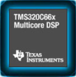
Agenda
Debug Architecture Overview
Advanced Event Triggering
DSP Core Trace
System Trace
Application Embedded Debug Support
Multicore System Analyzer (MCSA)
Indicates features that are new on the Keystone generation of the C6000 Family

Slide 3
Agenda
Debug Architecture Overview
Advanced Event Triggering
DSP Core Trace
System Trace
Application Embedded Debug Support
Multicore System Analyzer (MCSA)
Indicates features that are new on the Keystone generation of the C6000 Family

Slide 4
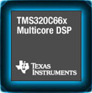
Debug Architecture Features
Advanced Event Triggering
Hardware Breakpoints/Watchpoints
Event Monitoring/Counting
Core Trace Control
DSP Core Trace
Export Program, Timing, Data, Event Info
System Trace
Export Bus Statistics and Events
Export Software Messages
Cross Triggering

Slide 5

Trace Data Capture Mechanisms
DSP Core Trace
Debug Port EMU pins for export to an external receiver*
Dedicated TI Embedded Trace Buffer (TETB)
4Kb on each core
System Trace
Debug Port EMU pins for export to an external receiver*
System Level TI Embedded Trace Buffer (TETB)
16Kb per device
* XDS560v2 Pro (In Beta) = 2GB

Slide 6
Embedded Trace Buffer (TETB)
Can be optionally drained “on the fly” to L2, shared, or external memories
Can trigger event on ½ full status or full status
Advantages
Virtually extends the limited ETB size
Data can be streamed from the device via Ethernet or any other transport

Slide 7
Debug Subsystem
Debug Subsystem
System Trace
TETB
System Trace
C66x CorePac
C66x CorePac
C66x CorePac
C66x CorePac
DSP Core Trace
Debug Port
DSP Core Trace
AET
DSP Core Trace
AET
DSP Core Trace
AET
TETB
AET
TETB
TETB
TETB
External Trace Receiver
Notes:
Key Points
Each CorePac has a copy of AET and its own XDS560 (Core Trace) unit. It also has an ETB where trace data can be captured on all cores simultaneously.
There is only a single set of pins out to the debug port. These pins either need to be shared across CorePacs or all dedicated to a single CorePac. The recommendation is to allocated all pins to a single CorePac in order to get the best trace bandwidth.
There is one System Level ETB which is shared between all cores for STM.
System Trace can also be sent out the pins. The pins used for System Trace are independent from Core Trace. (This may not always be the case. It’s possible that future device might multiplex pins.)

Slide 8
Agenda
Debug Architecture Overview
Advanced Event Triggering
DSP Core Trace
System Trace
Application Embedded Debug Support
Multicore System Analyzer (MCSA)
Indicates features that are new on the Keystone generation of the C6000 Family

Slide 9
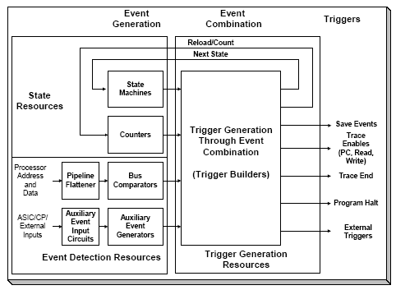
Advanced Event Triggering (AET)
Logic that can monitor
Program Bus Activity
Data Memory Bus Activity
System Events
Non-Intrusive / Real Time
Programmable at load or run time
Notes:
Key Points
AET is completely non-intrusive.
Simplest configuration is a hardware breakpoint (Generate a halt trigger when the PC is equal to a specified value).
More complex scenarios are possible, assuming the hardware is understood.
Use Cases:
Simple Use Case
Hardware breakpoint – Halt when PC address is a specified value
Hardware Watchpoint – Halt when Write address is a specified valu
Complex Examples
Store PC trace sample on every 10000th cycle. (Basis for statistical profiling)
Store data trace samples when a task other than Task A is executing and the write address is in the range between address B and C. (Monitor for a write to a tasks stack outside the context of that task)

Slide 10
Advanced Event Triggering Inputs
Input Logic
6 Dual Range Address Comparators
4 Program/Data Address w/ Value Qualify
2 Program Address Only
4 Auxiliary Event Generators
4 State Sequencer
2 Timers/Counters
With Min/Max Watermark Capabilities
….
Notes:
Key Points
This is not an exhaustive list, but these are the most popular inputs
Auxiliary Event Generators allow almost any system level event to be used as an input
Use Cases:
Watermark Counter – Can be used as a monitor for the longest latency for a specified interrupt over an indeterminate period of time.
Notes
The CCS breakpoint manager doesn’t currently give an interface to configure the State Sequencer. This can still be used with AETLIB.

Slide 11
Advanced Event Triggering Outputs (Triggers)
Output Logic (Triggers)
CPU Halt Request*
Interrupt
Counter Inc/Dec/Reset
Timer Start/Stop
Store Trace Sample (7 Streams)
Start Trace (7 Streams)
State Sequencer Transition
….
*Halt Request ignored when debugger not connected
Notes:
Notes
The CPU Interrupt Halt request is treated as a NOP when the debugger is not connected. A fielded application that might generate a halt trigger will not actually halt. This is by design.
The 7 Trace Streams are PC, Timing, Read Address, Read Data, Write Address, Write Data, and PC Tag
A Store Trace Trigger can be thought of as like a pushbutton light switch. When the switch is depressed, the light comes on. When it is released, the light goes off. So, for the AET Trigger Builder, when the condition generating the trigger is true, trace samples are stored. When it goes false, trace samples are not stored.
A Start Trace trigger can be thought of as a normal light switch. When the switch is flipped, the light comes on and remains on, until someone shuts it off. When the event for a start trace trigger is true, tracing is started and continues even after the logic of the trigger builder is false. In order to turn off the trace stream, a halt trace trigger must be issued.

Slide 12
Agenda
Debug Architecture Overview
Advanced Event Triggering
DSP Core Trace
System Trace
Application Embedded Debug Support
Multicore System Analyzer (MCSA)
Indicates features that are new on the Keystone generation of the C6000 Family

Slide 13
DSP Core Trace
Core Trace (aka XDS560 Trace, CPU Trace)
Allows real-time, non intrusive, cycle accurate logging of PC (PC Trace) and Data (Data Trace) activity on the DSP Memory Buses.
Captured Trace data is compressed by on-chip hardware, passed either to the ETB or an external receiver, and then decoded on the host (with CCS or a stand alone decoder)
Event Trace
Event Trace is similar to PC trace, but allows selection of a subset of events that are tagged within the Trace Output.
Notes:
Notes
Core Trace is single core focused. There is no means for cross core alignment yet.
Core Trace is similar to a Logic analyzer placed on the CPU Memory Busses. This is an important point. Reads/Writes that don’t use these busses cannot be traced . So EDMA reads/writes and CPU Register reads/writes are not able to be traced.
PC and Timing Trace compress nicely and when captured alone. Should always be able to be captured without any bandwidth issues.
Data Trace does not compress nicely and can cause bandwidth limitations. On average, Trace can capture a single data sample every ~80 cycles. (There is a fifo that eases this restriction, but it is only 8 samples deep and will easily overflow if this limit is passed more than very small periods of time.
Trace can be configured in two ways to handle bandwith issues.
It can be configured to just drop trace data when the bandwith limit is passed (This results in loss of trace data)
Or it can be configured to stall the processor to allow the fifo to be emptied. (This can cause non real-time execution)
The ideal situation, when capturing data trace, is to allow AET to filter the data being captured to only that which the user is interested.
With Event Trace, we don’t have the on/off triggers. Trace is just captured from the beginning. A set of events can be configured, and the program address where these events ccur will be highlighted in the trace.
Note the following limitation. Only a single event will be captured on any single sample, and these are prioritized by the input event number. So, if event 1, 3, and 4 all occur on the same cycle, the event trace will only indicate event 1. If only 3 and 4 occur, it will only indicate 3. It might be necessary to capture trace multiple times with different priorities in order to find what is actually occurring on each cycle. And, the least frequent events should be given the higher priority.

Slide 14
Agenda
Debug Architecture Overview
Advanced Event Triggering
DSP Core Trace
System Trace
Application Embedded Debug Support
Multicore System Analyzer (MCSA)
Indicates features that are new on the Keystone generation of the C6000 Family

Slide 15
System Trace
Allows System Level monitoring of Application Events and Resources
Two Options
Software Messages
Hardware Messages – Common Platform Tracer (CPTracer)
Notes:
Notes
The Software Messages are much like a printf, without the drawbacks of printf.
Drawbacks of printf
Consume many cycles of PC execution
Even worse, the CPU halts and waits for CCS to poll it to pull up the data.
Printf messages will always be printed in roder of the CPU when CCS polls, so data can look out of order
CP Tracer modules are Statistics Counters that periodically push their contents out the System trace port.

Slide 16
Software Messaging
Enabled By System Trace Library (STMLib)
Advantages over Standard Printf
Real-time
System Level Cycle aligned
Up to 240 User Defined Channels
Reduced capability library build (compact) also provided (< 1K )
STMLib is a component of the CToolsLib Family of libraries
Download free via Gforge: https://gforge.ti.com/gf/project/ctoolslib/frs/
Notes:
Notes
Channels simply allow the user to filter the data based on each channel.

Slide 17
Common Platform Tracer (CPTracer)
CPT Modules - Provide data for slave buses.
Profiling: Periodically export STM Messages for statistics counters
Throughput Counter 0,1 – Bytes of slave acknowledged accesses
Wait Counter – Number of cycles a master access must wait for slave acknowledge
Access Counter – Number of unique transactions
Event Logging
New Request
Last Read
Last Write

Slide 18
KeyStone CP Tracer Modules
Legend
Bridge
VUSR
Wireless Apps Only
CPU/2
256b
TeraNet
SCR
S
for EMIF_DDR3
(36b)
Media Apps Only
MSMC_SS
M3_DDR
S
CPT
M
CP Tracer
M3_SL2
S
CPT
4 CPTs for SRAM
(36b)
DDR3
VUSR
CPT
M
S
CPT
M
TPCC
16ch QDMA
TC0
M
CPT
EDMA_0
TC1
M
CONFIG
SRIO
XMC
X 4/ x 8
CPU/3
32b
TeraNet
SCR
x5
S
CP Tracer (x5)
x8
S
CP Tracer (x8)
CPU/3
128b
TeraNet
SCR
CPU/3
32b
TeraNet
SCR
x7
S
CP Tracer (x7)
x4 for Wireless
x8 for Media
S
CorePac
M
x2
S
S
TETB
TSIP
S
AIF2
SRIO
S
M
SRIO
x4
S
MPU
CPT
VCP2
M
S
Bridge 12
TCP3D
PA/SA
S
M
Bridge 13
TCP3E
SCR
CPU /2
x2
S
TPCC
S
TPCC
64ch
QDMA
TC2
M
S
TPTC
S
TC3
M
Bridge 14
S
TPCC
FFTC
TPCC
64ch
QDMA
TC6
M
SCR
CPU / 3
x4
TC4
M
S
TPTC
TC5
TC7
M
M
TC8
M
SCR
CPU / 3
x4
S
TPCC
TC9
M
S
TPTC
PA/SA
EDMA_1,2
Monitors transactions
from AIF,SRIO, Core, TCs
S
CPT
S
Monitors transactions
from AIF, TCs
TCP3e_W/R
S
CPT
TCP3d
MPU
CPT
S
Semaphore
TAC_FE
M
MPU
CPT
S
RAC_BE0,1
x2
QMSS
M
FFTC / DMA
M
S
CPU / 3
128b SCR
VCP2 (x4)
STM
TETB
CPU/6
32b
TeraNet
SCR
DebugSS
AIF / DMA
S
S
M
SEC_CTL
S
Global
Timestamp
MPU
CPT
PLL_CTL
QMSS
QMSS
S
M
S
Bootcfg
S
S
PCIe
PCIe
M
CPU/3
32b
TeraNet
Write-only
SCR
X8 / x16
Timer
CPU / 6
32b
TeraNet
SCR
EMIF16
DebugSS
S
S
GPIO
DAP (DebugSS)
S
M
CP Tracer (x5)
M
S
Boot ROM
STM
S
I2C
CPU / 3
32b
TeraNet
SCR
CP Tracer (x8)
S
M
INTC
x2
CP Tracer (x7)
S
M
Preliminary Information under NDA - subject to change
S
TSIP0,1
SPI
M
UART
S
S
TETB
…
Notes:
18
Notes
This slide shows the locations of the CP Tracer modules in Keystone.

Slide 19
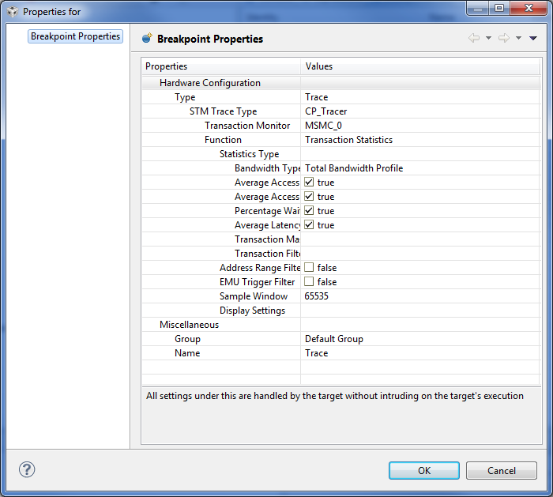
Configuration
CCS Breakpoint Manager
CPTracer Library (CPTLib)
Use Case based APIs
Enable/Disable functions allow isolation of Trace Data generation
CPTLibis a component of the CToolsLib Family of libraries
Download free via Gforge: https://gforge.ti.com/gf/project/ctoolslib/frs/

Slide 20
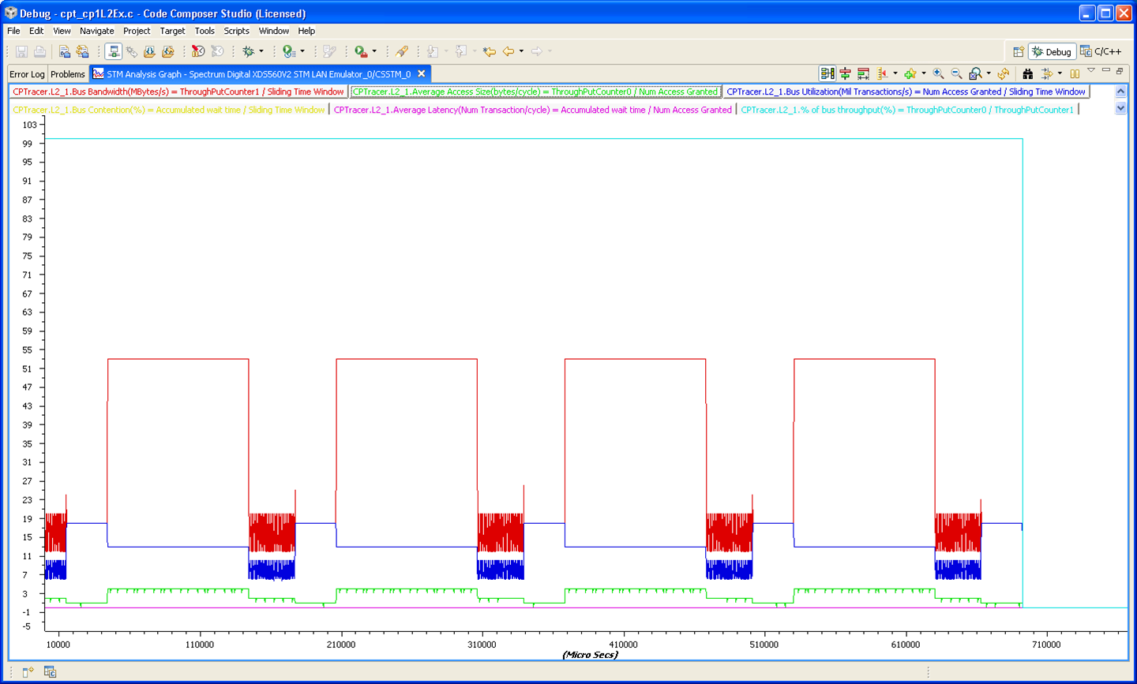
CPTracer Sample Output
http://processors.wiki.ti.com/index.php/CorePac_1_L2_CPT_-_CCS_setup_XDS560v2_System_Trace_Example
Notes:
Notes
This data initially appears in CCS as textual output, with a timestamp and value for each item. Once this has been captured, selecting Tools->Analysis->STM Graph plots the results like this.
The wiki page that this points to initially reflected steps for CCSv4 that were different than CCSv5. A request has been made for this to be updated. SDO had said that it would be updated the week of 04/16/2012.

Slide 21
Cross Triggering
Provides a means to propagate debug events from one processor to another.
Other processors can generate actions upon cross trigger
Sample Debug Events
Processor Entering Debug State
Watch Point Match
ETB Full
Sample Debug Actions
Restart
Interrupt Request
Start Trace

Slide 22
Agenda
Debug Architecture Overview
Advanced Event Triggering
DSP Core Trace
System Trace
Application Embedded Debug Support
Multicore System Analyzer (MCSA)
Indicates features that are new on the Keystone generation of the C6000 Family

Slide 23
Application Embedded Debug Support
CToolsLib – A suite of libraries that can be used for embedding debug elements into an application
AETLib
ETBLib
CPTLib
DSPTraceLib
STMLib
Available Free Via GForge: https://gforge.ti.com/gf/project/ctoolslib/frs/
Notes:
Notes
AETLIB – For configuring the programmation of triggers in the Advanced Event triggering. Also provides APIs for configuring and reading the AET timer/counters.
ETBLIB – For reading data from the Embedded Trace buffers on the fly.
CPTLIB – For configuring the CP Tracers to capture data
DSPTraceLib – For configuring Core Trace and the trace receivers from within an application
STMLIB – Implementation of the STM Software Message API

Slide 24
AETLib
Provides programmatic access to the Advanced Event Triggering logic
Advantages
Reuse of limited AET resources (task stack monitoring)
More granularity for enabling/disabling AET/Trace at specific points of the application
Capture of Trace data from fielded devices
Notes:
Use Case
Monitor task stacks for overflow by reusing AET resources. AETLIB reconfigures the AET resources to watch the top of the currently executing tasks stack. Without AETLIB, there are only enough resources to watch 1 data range at a time, and we can’t watch dynamic task stacks because we don’t know where they will be allocated.

Slide 25
ETBLib
Provides application access to configuration of the embedded trace buffer
Advantages
ETB can be configured without Debugger connection
Dynamic draining of ETB is supported
Events generated on half full and full
Data can be moved from ETB into internal memory and passed off via any transport (Ethernet, Srio, etc)
Virtually extend the size of the ETB

Slide 26
System Trace Libraries
STMLib
Application Interface to System Trace Software Messages
Advantages
Small function overhead
Real-Time
System Level Time Stamp
CPTLib
Application Interface to Common Platform Tracer Configuration

Slide 27
Agenda
Debug Architecture Overview
Advanced Event Triggering
DSP Core Trace
System Trace
Application Embedded Debug Support
Multicore System Analyzer (MCSA)
Indicates features that are new on the Keystone generation of the C6000 Family

Slide 28
Multicore System Analyzer(MCSA)
Suite of tools providing real-time visibility into performance and behavior of an application.
Information collected in various ways
Advanced Tooling Features:
Real-time event monitoring
Multicore event correlation
Correlation of software events, hardware events and CPU trace
Real-time profiling and benchmarking
Real-time debugging
http://processors.wiki.ti.com/index.php/Multicore_System_Analyzer

Slide 29
Analysis Features
Benchmarking: Finding out how long it takes some action to complete. Includes 'context aware' benchmarking for multi-threaded analysis
CPU and Task Load Monitoring: real-time visibility into how busy your system really is
O/S Execution Monitoring: monitoring task switches and the state of kernel objects such as semaphores
Filtering events
Multicore Event Correlation

Slide 30
Current/Future Features
Current
Future
Ethernet Transport
JTAG Stop-Mode
JTAG Run-Mode
Execution Graph
CPU Load
Task Load
Benchmark/Duration
Context Aware Profile
Statistics / Count Analysis
ETB Draining
CPU Trace, STM, UIA Correlation
Logging on Linux
Realtime Config & Software Instrumentation Control
USB Transport
STM Transport
Remote Debug
Back Trace
System Analyzer 1.0
MCSA User’s Guide
System Analyzer 1.1

Slide 31
Use Case: Bios Task Stack Monitor
Goal?
Configure Advanced Event Triggering to generate an interrupt when a value is written to the top 10% of the stack
What do we know?
Each Bios Task has it’s own Task Stack.
Advanced Event Triggering contains 4 32-bit Dual Range Comparators for watching Data Address Bus
Assumptions
Application has 5 tasks; 3 statically generated; 2 dynamically generated

Slide 32
Application View
TSK0
TSK1
TSK2
TSK3
TSK4
Each Task has it’s own stack
Tasks have different stack sizes
Blue – Statically Allocated
Red – Dynamically Allocated

Slide 33
Dual Range Comparators
4 Connected to Data Buses
32 Bits
Multiple Configurations
GT
GEQ
LT
LEQ
EQ
T1
T2

